Slide 1
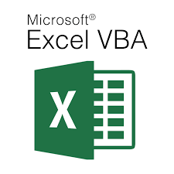
Visual Basic for Application - Theoretical (Lecture 5)
Written By: Kim M Pambid
Reference:
https://learn.microsoft.com/en-us/
https://www.wallstreetmojo.com/
https://www.automateexcel.com/
https://stackoverflow.com/
https://www.wikipedia.org/
https://www.techonthenet.com/

Slide 2
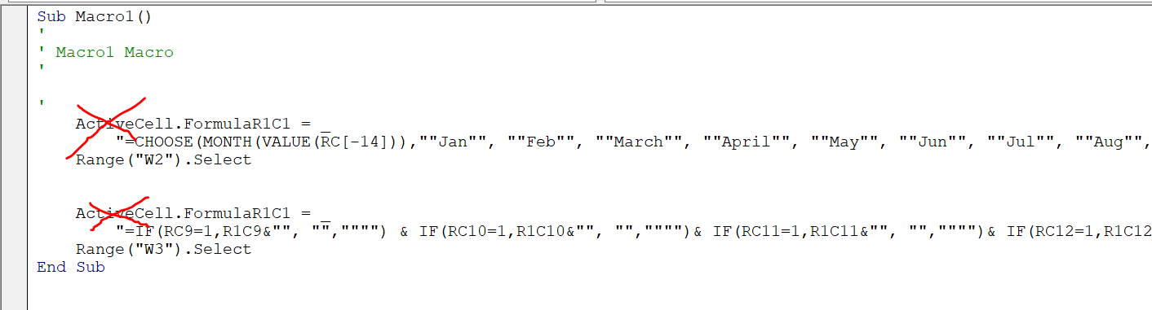
Record Macro Formula / Macro Alterations
a.1. Avoiding Select, Selection, and Active
You may find this structure in the record macro.
The red x above are pre-set objects and variables. This means if there are any movement with the user while running the macro will
Change the outcome/result of the report.
Avoid using the following objects/functions below:
1.) ActiveCell.
2.) ActiveWorkbook.
3.) ActiveWorkbook.
4.) Selection.
5.) .Select
6.) .Activate

Slide 3
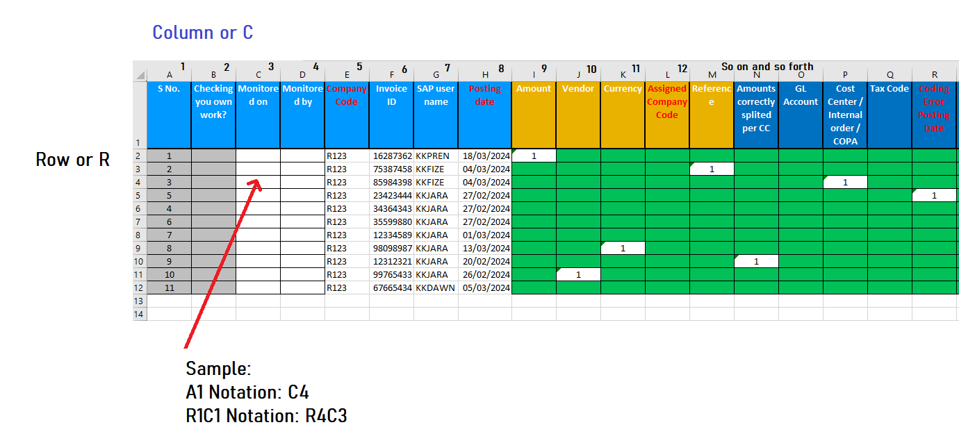
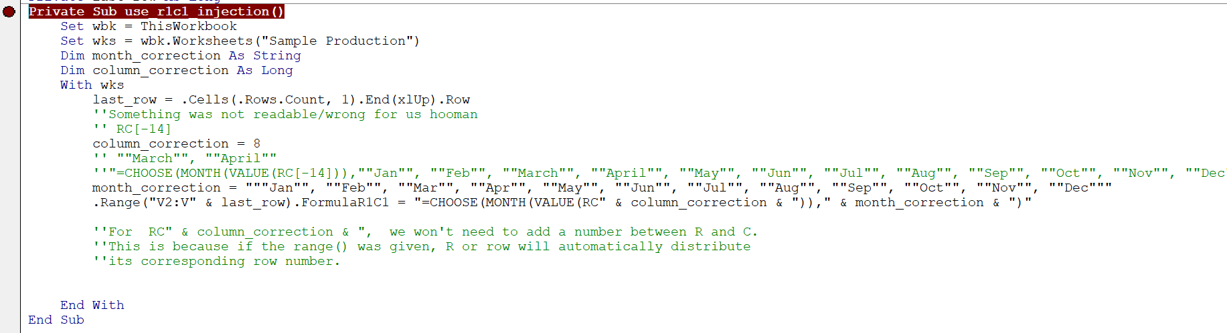
a.2. R1C1 Variable Injection / Dynamic R1C1
R – Row
C – Column
Readable R1C1 notation.

Slide 4
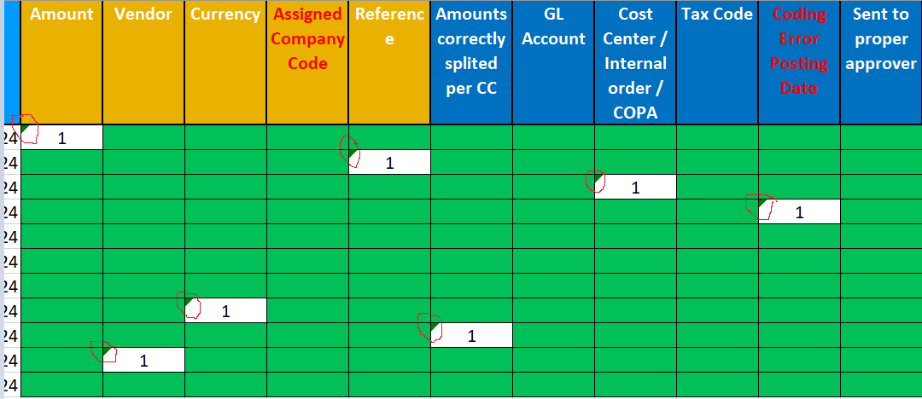
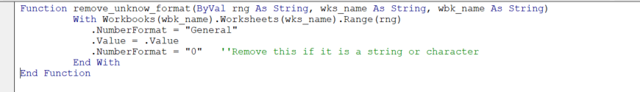
a.3. Unreadable format for R1C1 Formula
The formula will not work in an unreadable/unknown format (green triangle).
Solution:

Slide 5
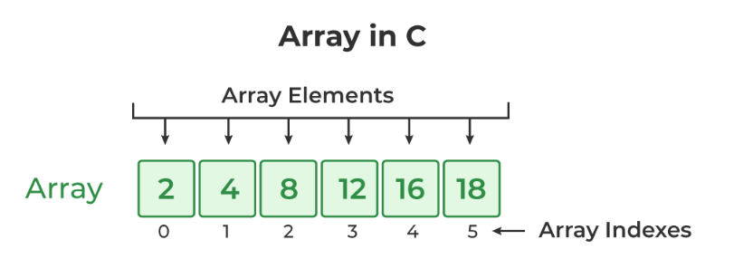
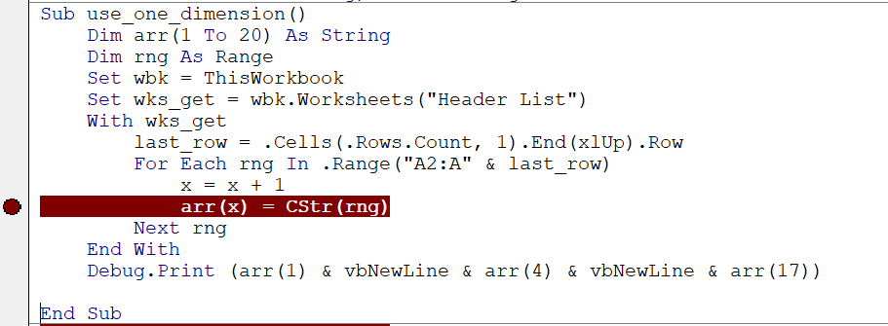
B. Recalling Arrays
An array is a fixed-size collection of similar data items stored in contiguous memory locations.
It can be used to store the collection of primitive data types such as int, string, double, etc.
b.1. One Dimensional Array - is the simplest form of an Array in which the elements are stored linearly
and can be accessed individually by specifying the index value of each element stored in the array.

Slide 6
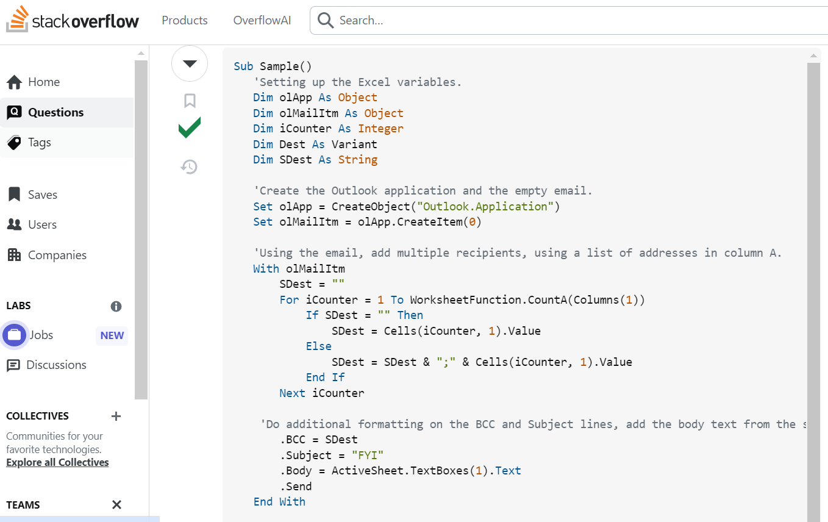
C. Google Search / Googlyst ☺
When looking for a VBA function (Stackoverflow, ChatGPT, Etc), you should identify the following components before inserting them into your VBA script. This will prevent some inaccurate output and give you an idea of which parts are actually needed.
Search sample

Slide 7
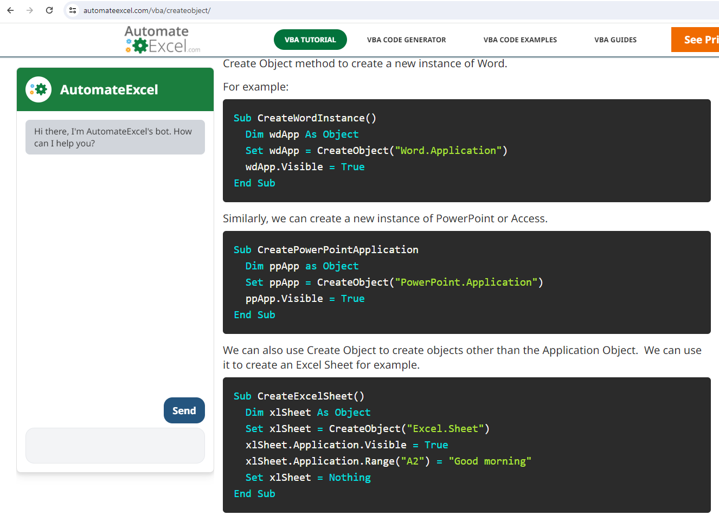
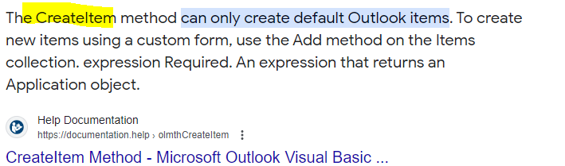

Slide 8
30 mins review

Slide 9
Knowledge Check Quiz
5 Questions : )

